Slide 1
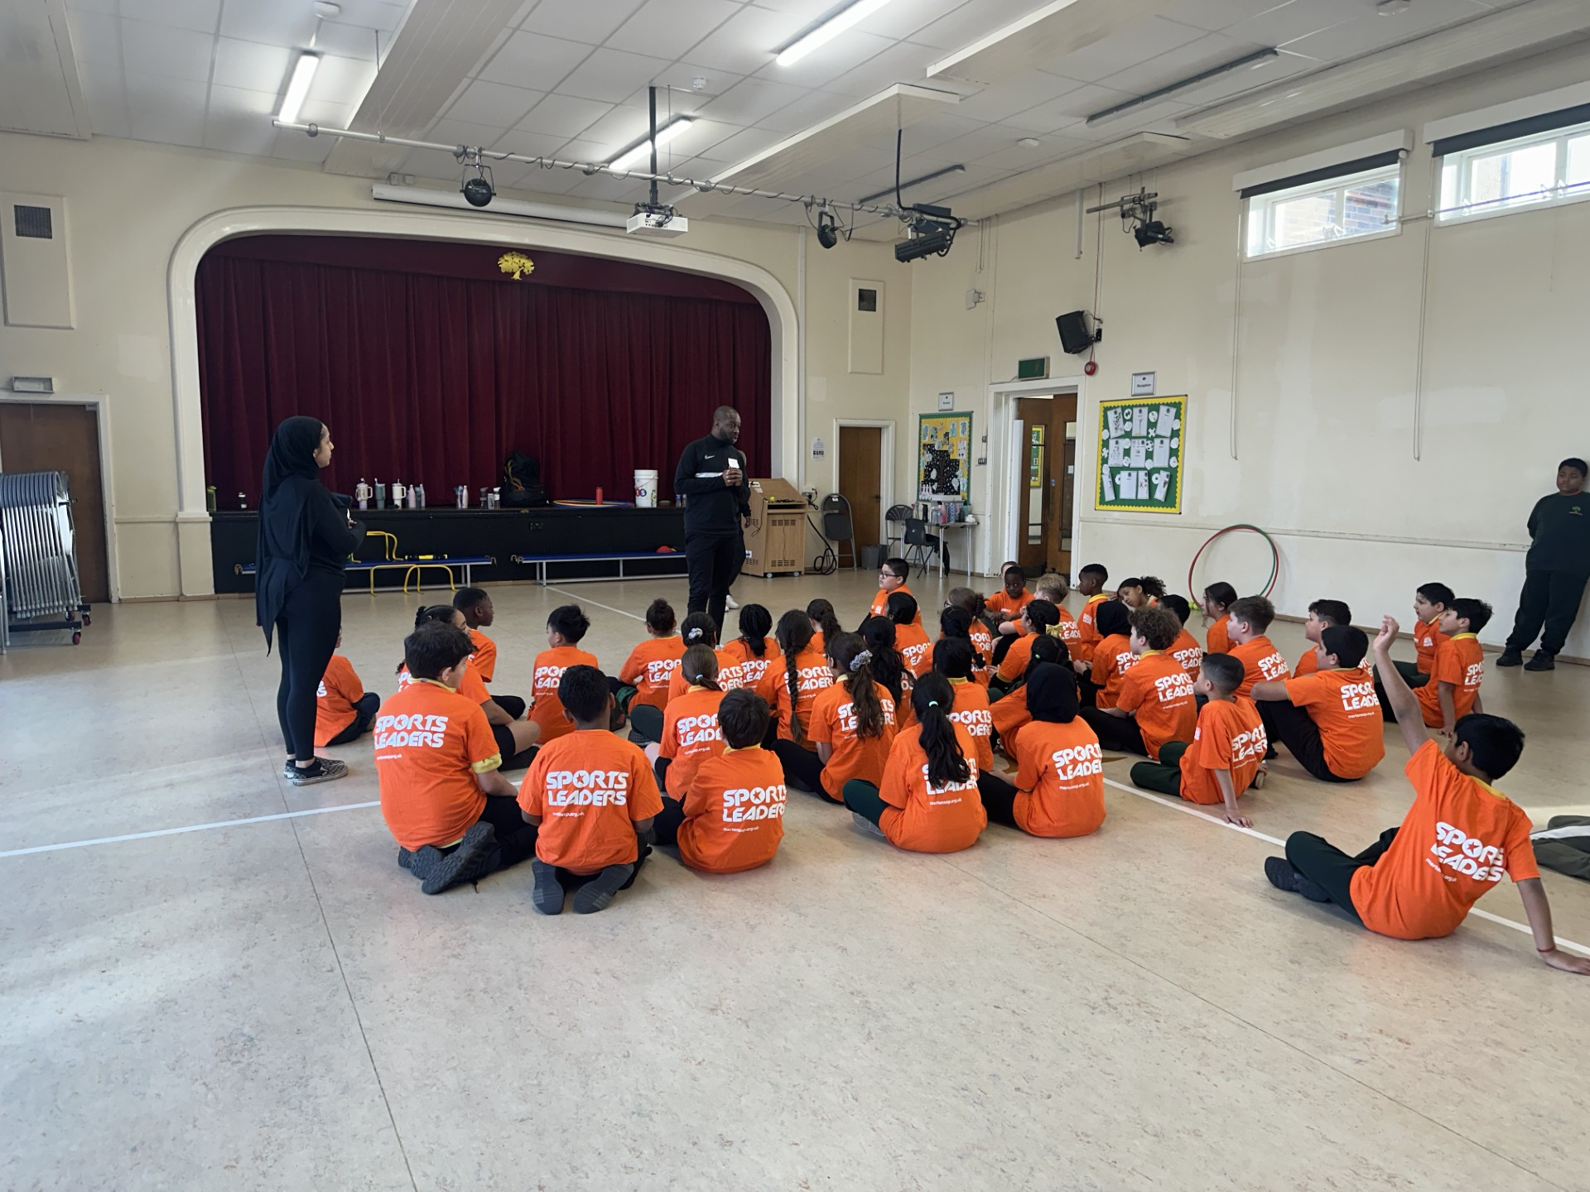


INSPIRATION DAY CLASSROOM TASK
2025-2026

Slide 2

INSPIRATION DAY
Classroom Session

Slide 3
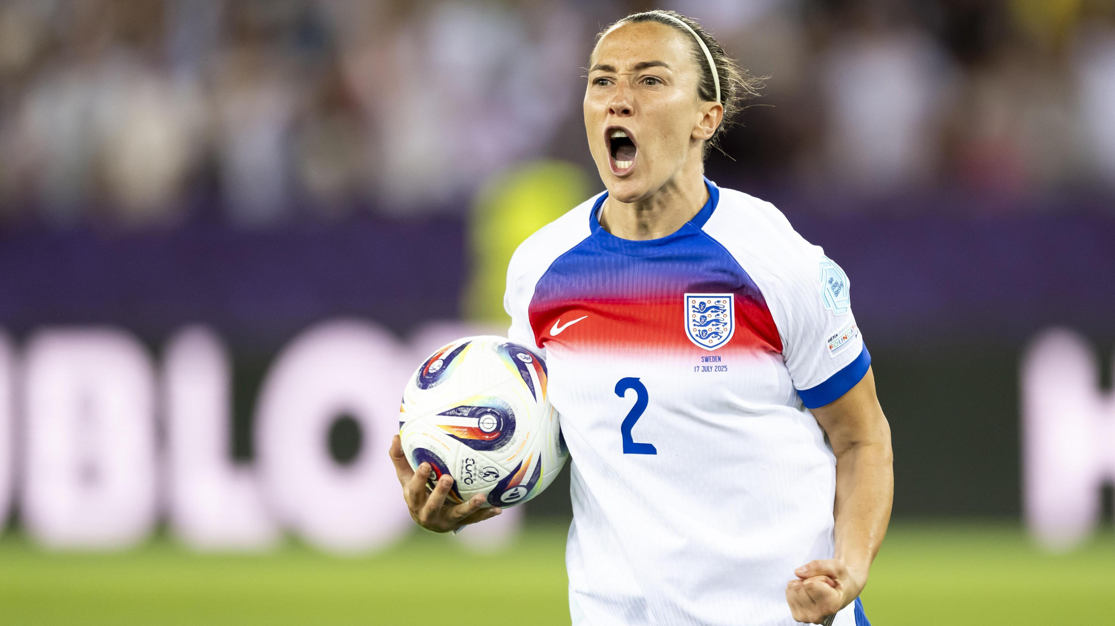
Congratulations!
WELL DONE YEAR 5! You have completed the first part of your sports leaders training. Now for part 2:...

Slide 4
Classroom Tasks
There are 3 short tasks that we will complete, to help improve your ability to be an excellent sports leader.
6 key principles of sports leadership (small groups)
Make a Mini Game (small groups)
Plan for this afternoon's PE lessons (small groups)

Slide 5
Recap Quiz
What is the most important thing to consider when leading any game or sport for younger children?

Slide 6
Recap Quiz
Write down 2 different reasons you might need to adapt a game you are leading.

Slide 7
Recap Quiz
As well as explaining a game with words, it is important that you also do what?

Slide 8
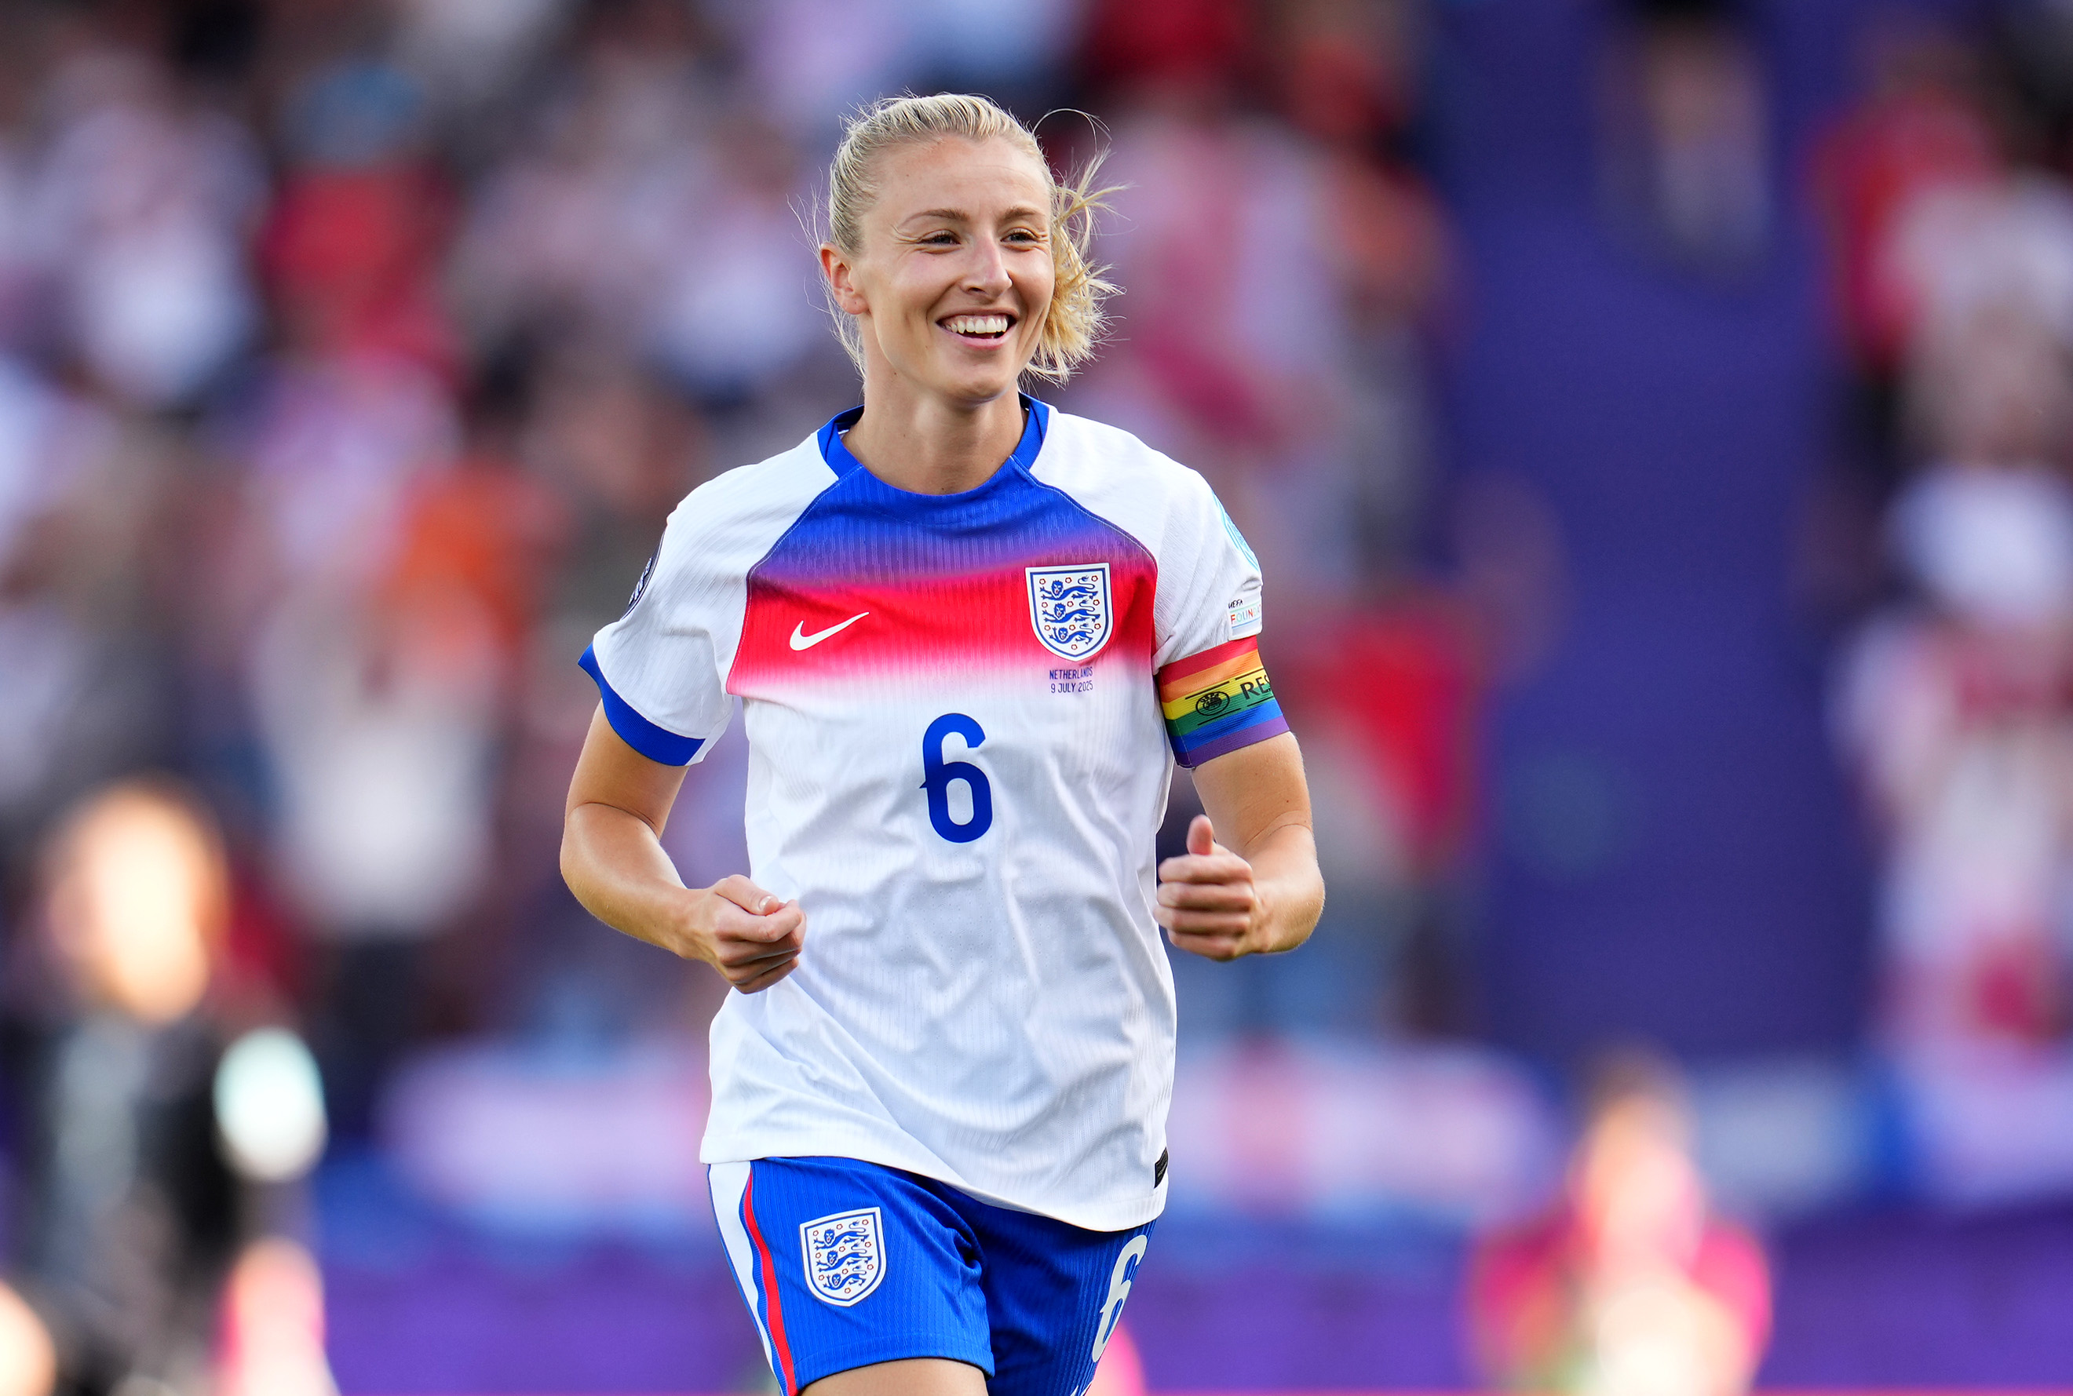
6 key principles of Sports Leadership

Slide 9
6 key principles of Sports Leadership
Here are 6 key principles of sports leadership, along with their definitions – but they are all muddled up.
All you need to do is match the word to its correct meaning.
When you finish, think about why each rule is important when playing sport with young children.

Slide 10
SAFETY – Making sure no one will get hurt or be in danger
ORGANISATION – Planning what you are going to do and being prepared
COMMUNICATION – Being able to explain or demonstrate an activity, so that others understand
CO-OPERATION – Working well with others without arguing
ENJOYMENT – Making something fun so that people enjoy doing it
RESPONSIBILITY – Giving everyone a chance to speak, making fair decisions and not blaming others

Slide 11
6 rules of sports leadership
SAFETY – Games, area and equipment
ORGANISATION – Being prepared
COMMUNICATION – Simple instructions and always demonstrate
CO-OPERATION – Teamwork
ENJOYMENT – Make it fun!
RESPONSIBILITY – Be a good role model, be fair and respect everyone

Slide 12
Make A Mini Game!
Each group will now create a very simple game using only some:
Cones
Beanbags or Balls
Hoops
Bibs
You must decide only 4 Things
Game Name - What do you want to call it?
How To Play
Safety Rule
Inclusion

Slide 13
Make A Mini Game!
How to Play (2–3 rules only):
Throw the beanbag into the hoop run to collect cones.
Roll the ball to knock over cones.
Keep rules short and clear.
NO TAG GAMES, sorry! Skill games only.
Safety Rule (choose two)
Stay in the marked area
No pushing
Only roll or underarm throw
Watch where you’re going?
Inclusion Rule (choose two rules to help everyone)
Players can walk or run
Use a closer/further throw line for those who need it.
Everyone gets as many turns as possible

Slide 14
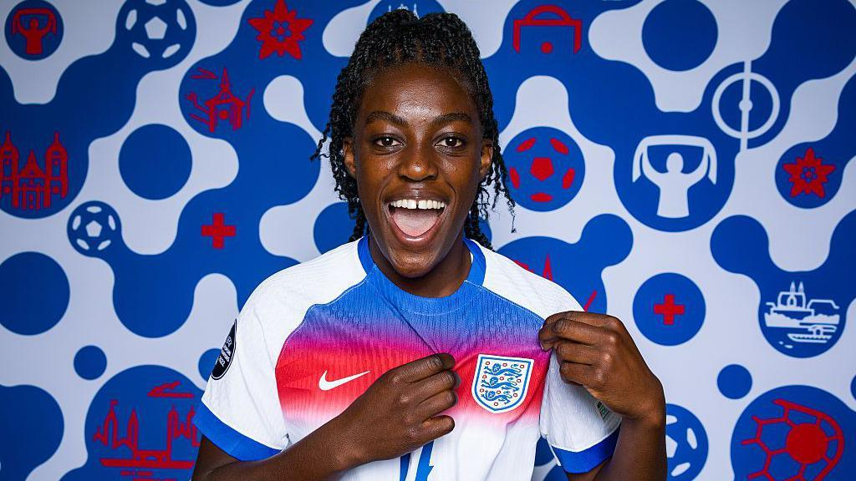
Make A Mini Game!
Quick Share (3 minutes per group)
We will ask each group to explain their game to another group.
The group with the best game (decided by Abby and Fraser) will be allowed to teach it this afternoon!

Slide 15
Afternoon PE Lesson Planning
In your groups, we are going to give you two of the games from this morning, to deliver this afternoon in PE. (One for KS1, One for KS2)
You will need to be able to clearly explain and demonstrate to the children what they need to do to play the game. While they are playing you will need to motivate them and have ideas of how you might need to adapt the games.
You will have to lead your station for around 6 minutes..

Slide 16
Afternoon Lesson Planning
You will need to think about:
What equipment will you need?
How will you make the game safe?
How will you adapt the game for children who are finding it too easy?
How will you adapt the game for children who are finding it difficult?
Who is doing what?
Which of our 6 rules does this part of the day cover?

Slide 17
Summary – Plan for the rest of the day
Lunch
KS1 PE lesson practise
KS2 PE lesson practise
Feedback/Certificates/What happens next??

Slide 18
  Quiz Time!
Fill in the blanks….
S -
O –
C –
C - Communication
E - Enjoyment
R -

Slide 19
  Quiz Time!
Name the three female footballers we have mentioned since break time?

Slide 20
  Quiz Time!
Name 3 of the games you have played today?

Slide 21
  Hangman
  Another England Female Footballer

Slide 22
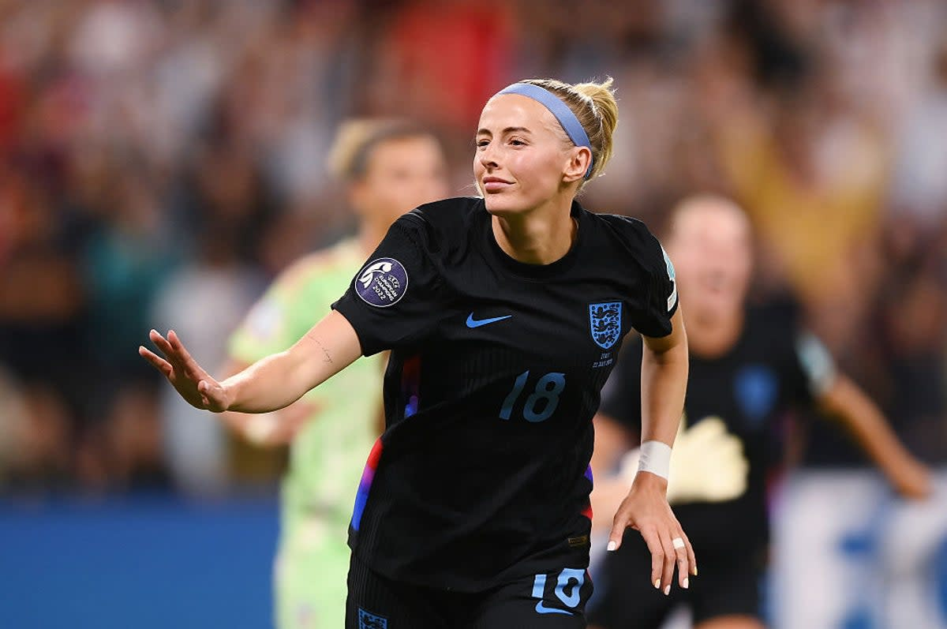
Lunchtime!

